Slide 1
Movie Recommendation System
林大衛
資工四
104590050

Slide 2
Table of contents
1. Types of recommender systems
2. Content based filtering
3. Collaborative filtering
4. Collaborative filtering using k-nearest neighbors
5. Collaborative filtering using matrix factorization
6. demo

Slide 3
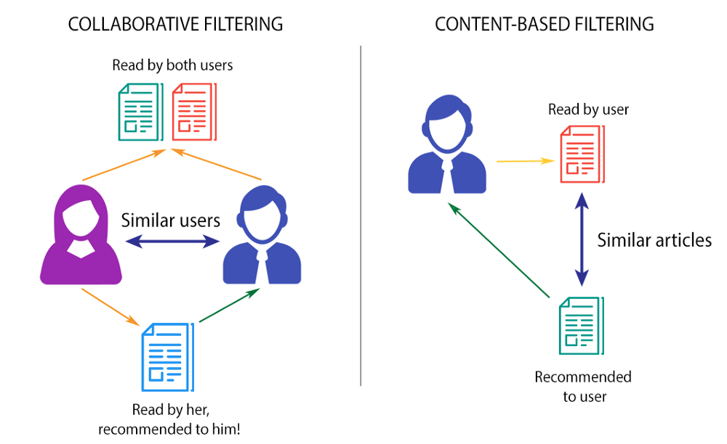
Types of recommender systems

Slide 4
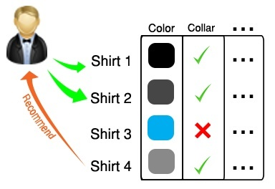
Content based filtering
Utilizes the characteristics of an item in order to recommend items with similar properties.

Slide 5
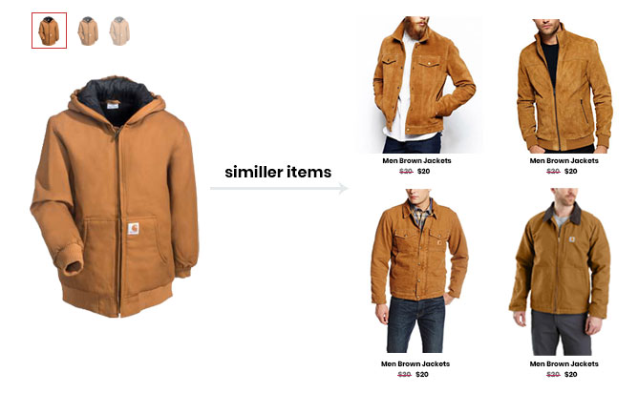
Content based filtering’ problem
Recommends only similar items to what the user already has.

Slide 6
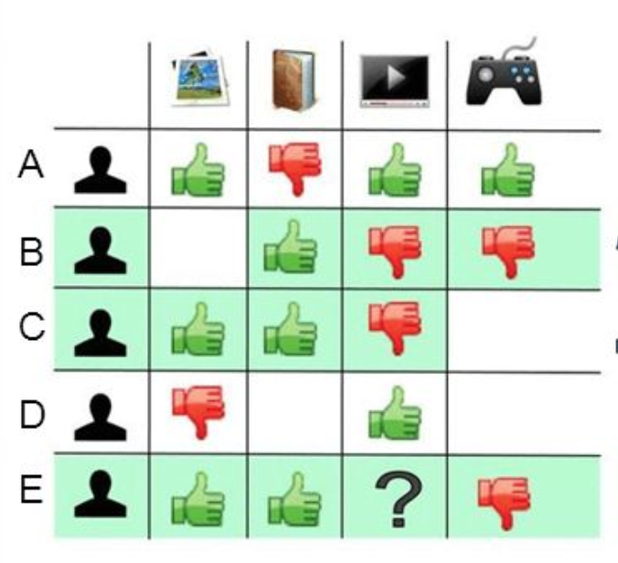
Collaborative filtering
Takes into account the user’s past behavior as well as similar decisions of other users in order to make a model which is later used to predict items that the user may like.

Slide 7
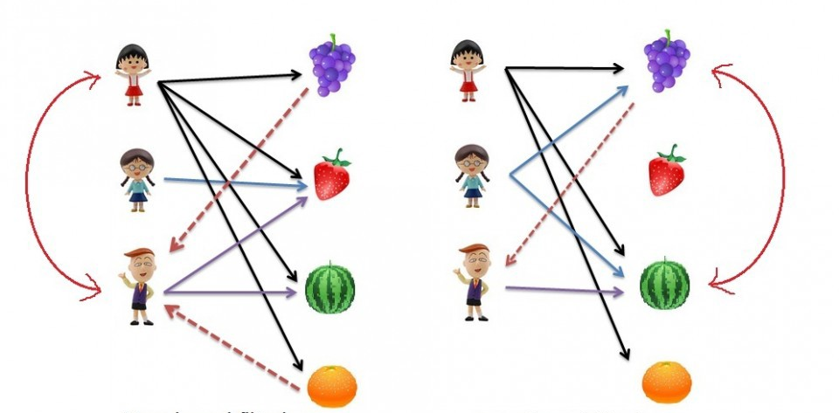
Collaborative filtering
User based filtering
Item based filtering

Slide 8
Item based or user based?
User based:
May have very sparse ratings.
Suffer from cold start.
Users might change his taste.
Item based:
Can make predictions even for new users.
Items are simple and never change.

Slide 9
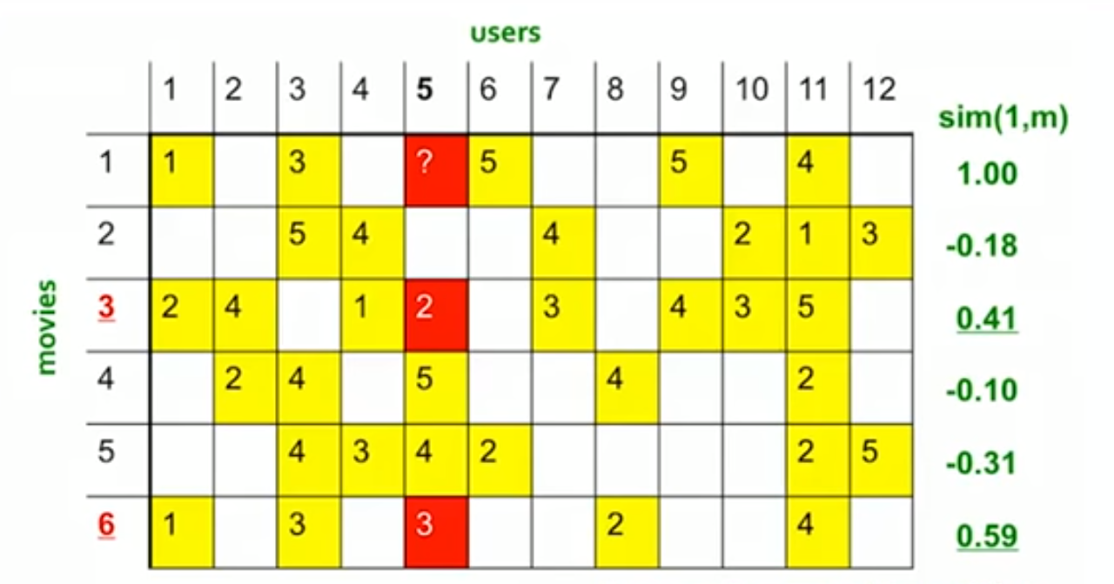

Making predictions using the k-nearest neighbor algorithm

Slide 10
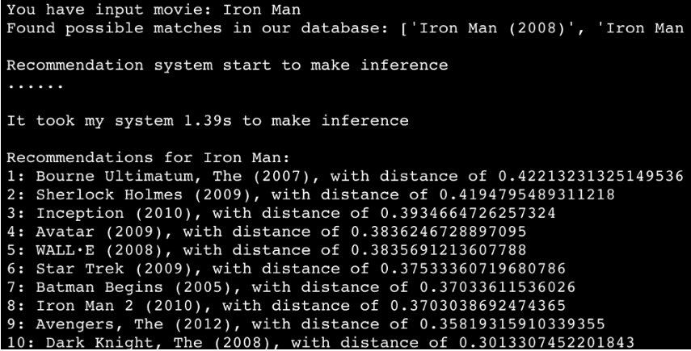
Problems with the knn approach
Computing the top k similar movies with this approach will often lead to a popularity bias, meaning that the movies recommended will most likely be popular movies rated by many users. This makes the less popular, or simply newer movies unlikely to be recommended to a user.

Slide 11
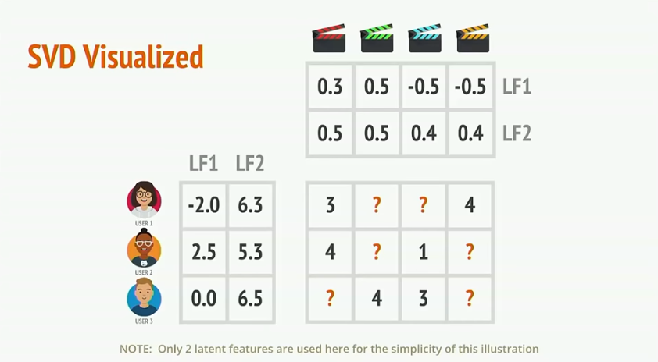
Making predictions with matrix factorization

Slide 12
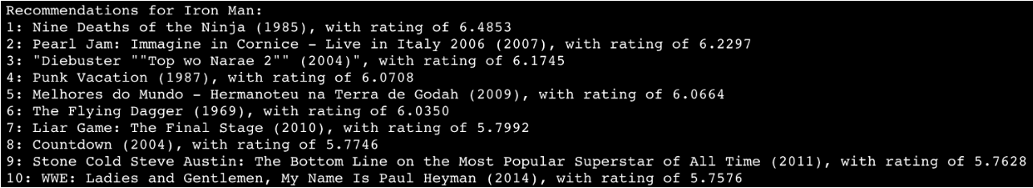
Movies similar to Iron Man using matrix factorization

Slide 13
Demo

